Slide 1
http://www.youtube.com/watch?v=qHTBo4TNuwQ
http://www.youtube.com/watch?v=UCD2cp2b42E&feature=fvwp&NR=1
http://www.youtube.com/watch?v=QKcyA5GtNHc

Slide 2
That´s amazing terrific talents
Basic 08 - Unit 11 Lesson A

Slide 3


Slide 4


Slide 5
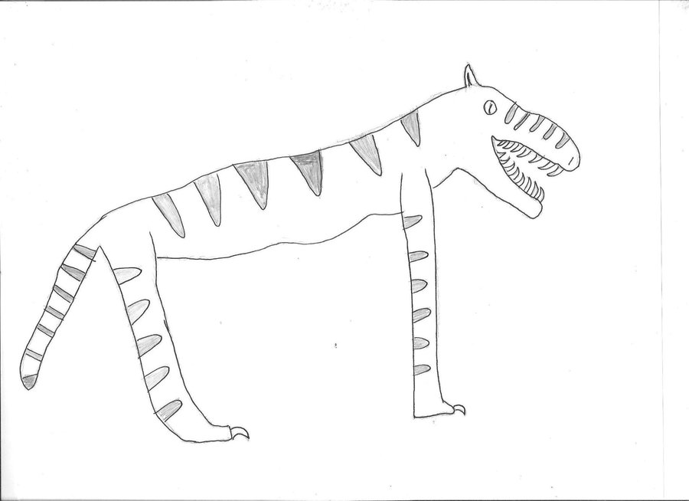

Slide 6
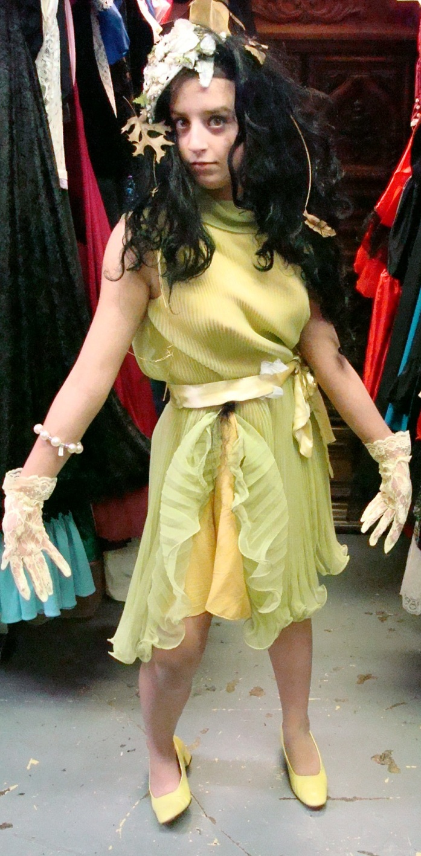
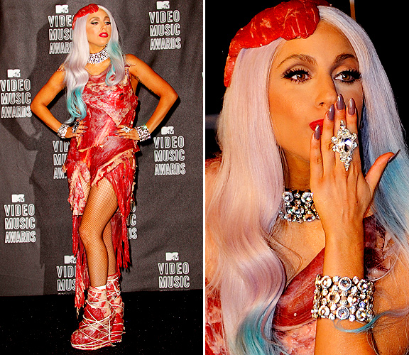

Slide 7

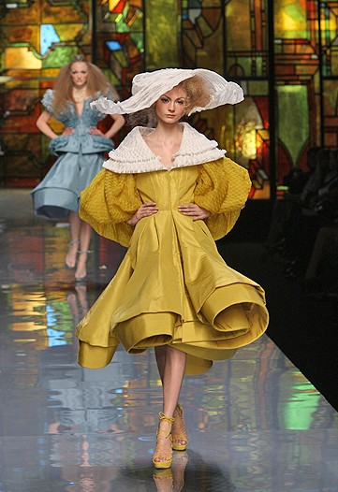
Couture

